Slide 1
ADDERS

Slide 2
Circuits for Binary Addition
Half Adder
Half-adder Schematic

Slide 3
Full Adder
S = CI xor A xor B
CO = B CI + A CI + A B = CI (A + B) + A B

Slide 4
Cascaded 4 BIT
Parallel Adders / Ripple Adder
Parallel adders are digital circuits that compute the addition of variable binary strings of equivalent or different size in parallel. The schematic diagram of a parallel adder is shown, to add two 4 bit binary numbers. The circuit is laid out from right to left, similar to the way we add binary numbers. Therefore, the least significant column is on the right, and the most significant column is on the left. The boxes labeled FA/+ are full adders. The Carry out from each full adder is the Carry-in to the next higher full adder.

Slide 5
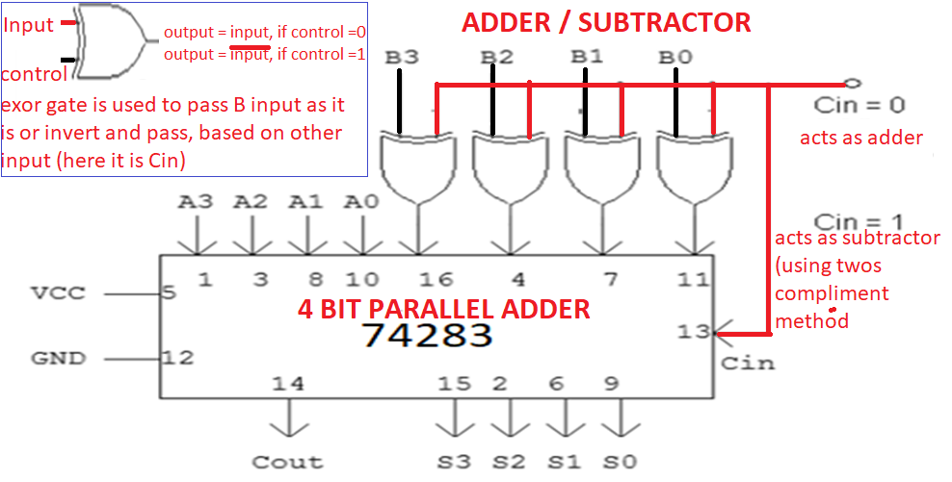
4 BIT Adder / Subtractor
The numbers being processed are A4 A3 A2 A1and B4 B3 B2 B1, while the answer is S4 S3 S2 S1. 4 bit adder is built as described in the previous slide, using 4 numbers of single bit full adders. Here ExOR gate is used, control the circuit to work as an 4 bit adder or 4 bit subtractor.

Slide 6
4 BIT Adder / Subtractor Examples:
Perform addition of following numbers, given in binary form
1000
1100
-------
10100
Perform addition of following numbers, given in decimal number system.
15 - 1111
+9 - 1001
---- -----------
1 1000
Perform addition of following numbers given in hexadecimal number system
A 1010
1001
-- ---------
1 3 1 0011
Note: for subtraction, take the 2s compliment of second number and add to the first number. Note, the carry will be the opposite of the actual value

Slide 7
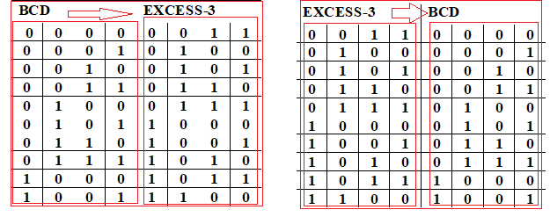
Application of Adder: used for Excess-3 to BCD Converter, vice versa
Binary Coded Decimal: Binary Coded Decimal is a method of using binary digits to represent the decimal digits 0 through 9. It is possible to assign weights to the binary bits according to their positions. The weights in the BCD code are 8, 4, 2 and 1. Ex: (137)₁₀ - BCD equivalent (0001 0011 0111)_{2.}
Excess-3 Code: This is an un-weighted code. Its code assignment is obtained from the corresponding value of BCD after the addition of (0011)₂.
BCD to Excess-3 (or) Excess-3 to BCD: Since each code uses four bits to represent a decimal digit, there must be four inputs and four output variables. The input variable are designated as B3, B2, B1, B0 and the output variables are designated as E3 , E2, E1, E0 in the truth table.

Slide 8
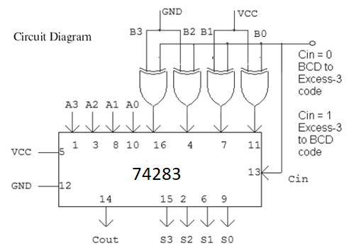
Application of Adder: used for Excess-3 to BCD Converter, vice versa
During the BCD to Excess 3 conversion: 0011 is applied to B3 B2 B1 B0 INPUTS of 4 bit adder (GND-0,VCC-1).
During Excess 3 to BCD conversion, 3 (0011) is subtracted from the number, using twos compliment method.

Slide 9
Delay Analysis of Ripple Adder
Carry out of a single stage can be implemented in 2 gate delays (Units of Time)
For a 16 bit adder, the 16th bit carry is generated after 16 * 2 = 32 gate delays.
Total Time Required for N bit adder using Ripple parallel adder = N * 2
Takes too long - need to investigate FASTER adders!
Carry Look Ahead Adders, CLA adders, overcomes the disadvantage of taking more units of time. The principle behind design of CLA adders, can be understood by looking at the equation for carry generated at the ith stage, Ci+1, for full adder
Ci+1 = Xi Yi + Xi Ci + Yi Ci

Slide 10
Let us write S and Cout expressions for full adder, in terms of inputs X and Y and Cin, for ‘i’ th bit
Si = Xi .xor. Yi .xor. Ci
Ci+1 = Xi Yi + Xi Ci + Yi Ci
= Xi Yi + Ci (Xi + Yi)
= Xi Yi + Ci (Xi .or. Yi)
Let us represent, XiYi by Gi (also called as Carry generate function) &
Xi.or.Yi by Pi (also called carry propagate function)
= Gi + Ci Pi
Now, lets write the these expressions, for C1,C2,C3 and C4
C1 = G0 + P0 C0
C2 = G1 + P1 C1 = G1 + P1 G0 + P1 P0 C0
C3 = G2 + P2 C2 = G2 + P2 G1 + P2 P1 G0 + P2 P1 P0 C0
C4 = G3 + P3 C3 = G3 + P3 G2 + P3 P2 G1 + P3 P2 P1 G0 + P3 P2 P1 P0 C0
Important: Carry input at each stage is direct function of operand bits. Thus the idea of having SUM and CARRY outputs of the ith stage be a function of xi,yi and ci is replaced by having these outputs be a function of x0,x1,…,xi, y0,y1,…,yi and c0

Slide 11
C1 = G0 + P0 C0
C2 = G1 + P1 C1 = G1 + P1 G0 + P1 P0 C0
C3 = G2 + P2 C2 = G2 + P2 G1 + P2 P1 G0 + P2 P1 P0 C0
C4 = G3 + P3 C3 = G3 + P3 G2 + P3 P2 G1 + P3 P2 P1 G0 + P3 P2 P1 P0 C0
C0
C0
C0
P0
C1
P0
P0
G0
P1
P1
P2
P2
G0
P3
C0
P1
G0
P0
P2
P1
P1
P2
G1
C3
P3
G0
C2
P2
G1
P1
P2
G2
P3
G1
G2
C4
P3
G3

Slide 12
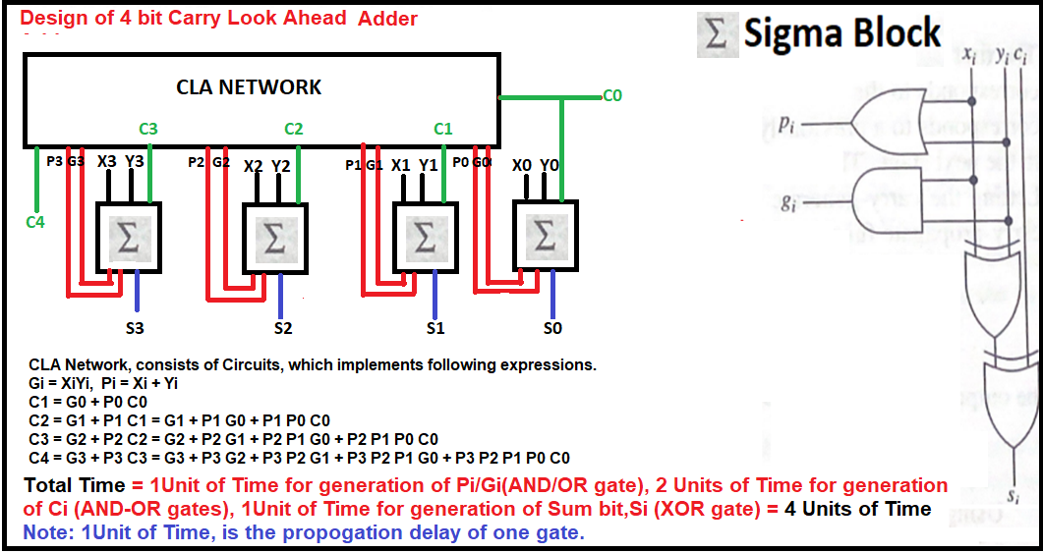
ADDERS

Slide 13
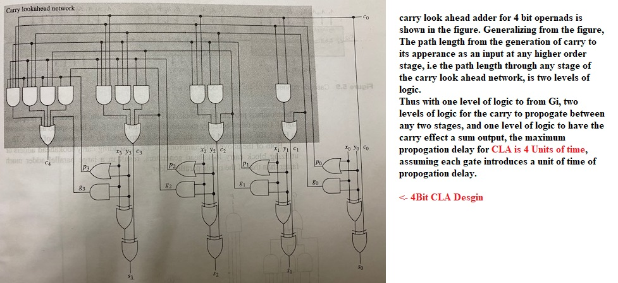
Carry Look Ahead Adder (following diagram for understanding)

Slide 14
Even though CLA performs high speed addition based on the carry look ahead principle, it presents a limitation in the realization of large high speed adders. The carry lookahead network can get quite large in terms of gates and gate inputs as the number of bits in the operands increases.
One approach to circumvent this problem is to divide the bits of the operands into blocks. Then, by using carry look ahead adders/carry look ahead generators for each block, their cascade connection results in a large high speed adders.
Cascading CLA adders
Using block CLA generators

Slide 15
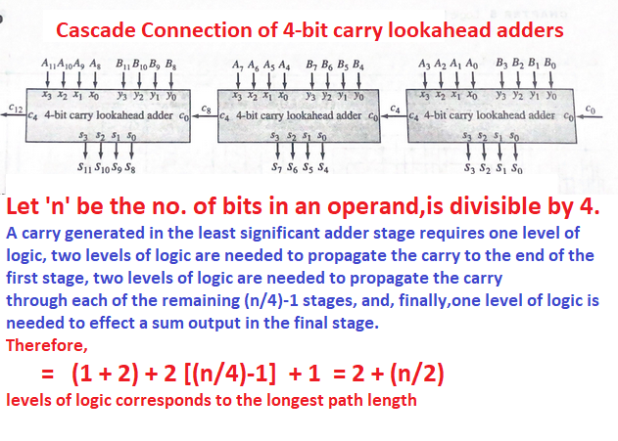
Note: in this case ripple carries occur between the cascaded 4 bit carry look ahead adders

Slide 16
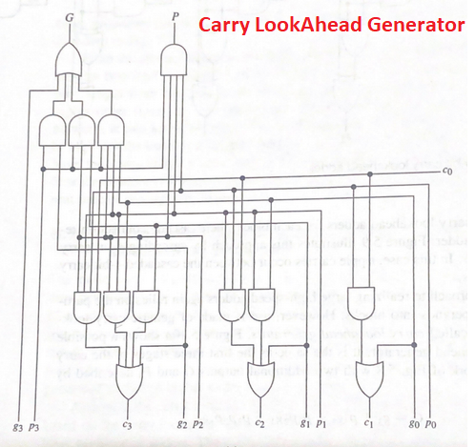
Carry lookahead generator (Extra Info – Not in syllabus)
It is the same as the first three stages of the carry look ahead network (of CLA adder), with two additional G and P, known as “block carry generate signal” and “block carry propagate signal”
G = g3 + p3g2 + p3p2g1 + p3p2p1g0
P = p3p2p1p0
**Extra info: Not in syllabus**

Slide 17
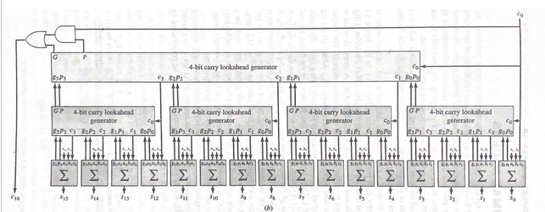
Using these 4 bit carry lookahead generator, the 16 bit high speed
adders are realized (Extra info: not in syllabus)

Slide 18
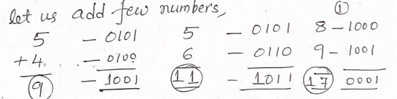
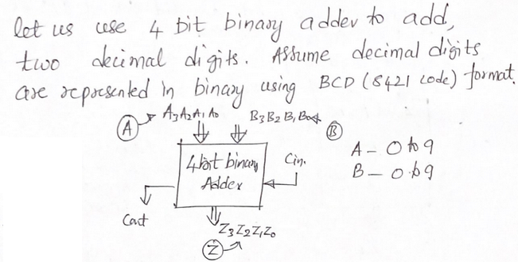
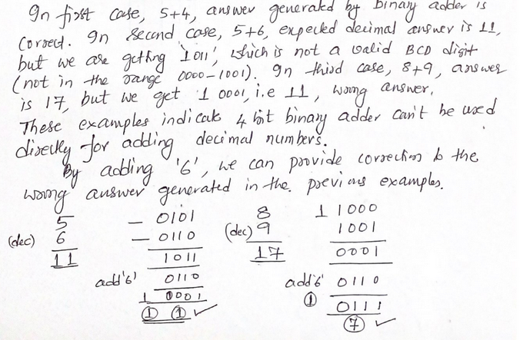
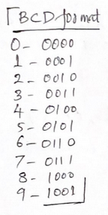
Decimal Adder

Slide 19
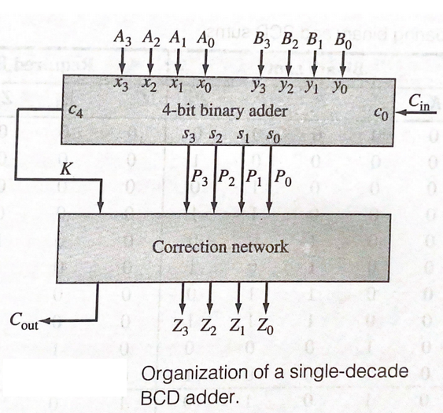
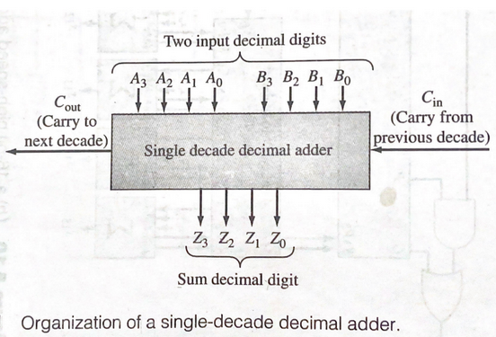
Decimal Adder

Slide 20
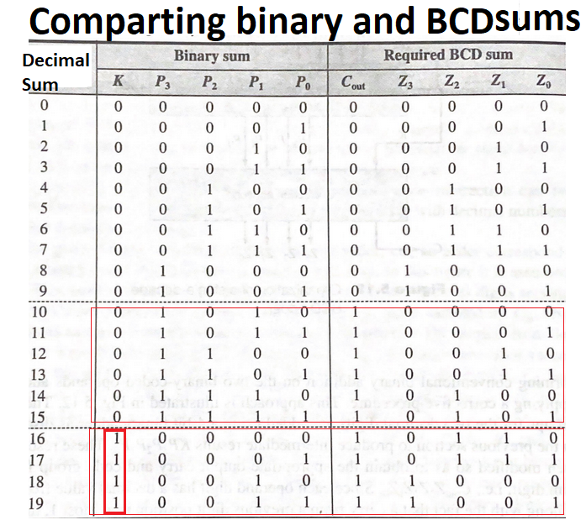
If the sum of the two decimal digits and input carry is less than 10, the required BCD sum is same as Binary Sum, produced by the 4 bit binary adder,
K P3P2P1P0 = Cout Z3Z2Z1Z0
The correction, of adding ‘6’ is required in two cases.
Answer is invalid BCD codes, (A to F), decimal sums of 10 throguh 15
K P3P2P1P0 –>0 1010, 0 1011, 0 1100,
0 1101, 0 1110, 0 1111
Answer produces, the Carry, decimal sums 16 through 19
K P3P2P1P0 -> 1 0000, 1 0001, 1 0010,
1 0011

Slide 21
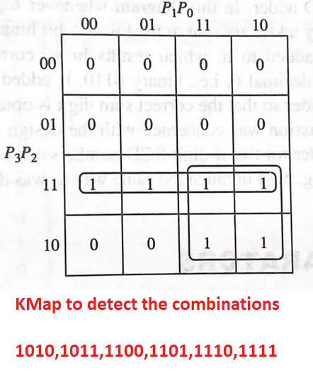
from the Kmap
ADD_6 = P3P2 + P3P1
Including the Carry output (K), in the expression, the Boolean expression for adding the correction is
ADD_6 = K + P3P2 + P3P1

Slide 22
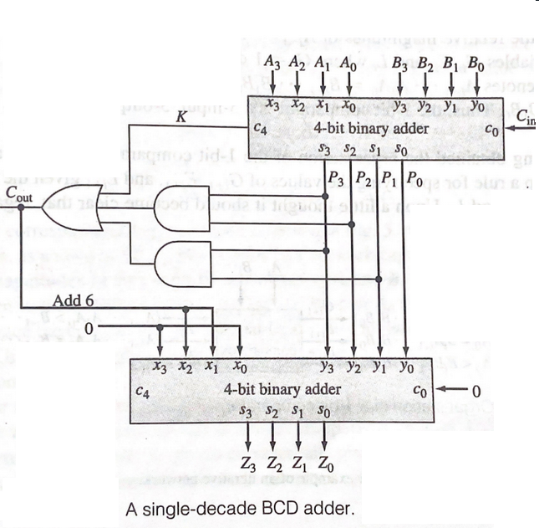
Corrective network is realised using another 4 bit binary adder, whenever ADD_6 is true, 0110 (6) is applied as one of the inputs to second adder, to add 6 to the result produced by the first adder.
Final Cout of the BCD adder is same as ADD_6 output.
In this diagram, Whenever Cout (i.e ADD_6) Is 0, the output of the first adder is added with 0. Whenver Cout (ADD_6) is 1, the output of first adder is added with 6 (0110).
Note: Final Cout can also be generated using “OR” of Cout from first adder and Cout from second adder.
Cout = Cout_1 + Cout_2

Slide 23
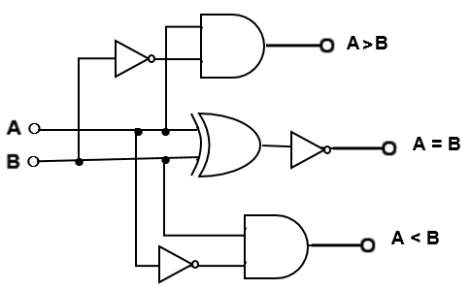

Comparators
Compare the magnitude of two binary numbers for the purpose of establishing whether one is greater than, equal to, or less than the other.
A magnitude comparator is a combinational circuit that compares two numbers A and B and determines their relative magnitude. The outcome of the comparison is specified by 3 binary variables that indicate whether A = B or A< B or A>B.
Design of 1bit Comparator
Inputs |  | Outputs
A | B | A<B | A=B | A>B
0 | 0 | 0 | 1 | 0
0 | 1 | 1 | 0 | 0
1 | 0 | 0 | 0 | 1
1 | 1 | 0 | 1 | 0

Slide 24
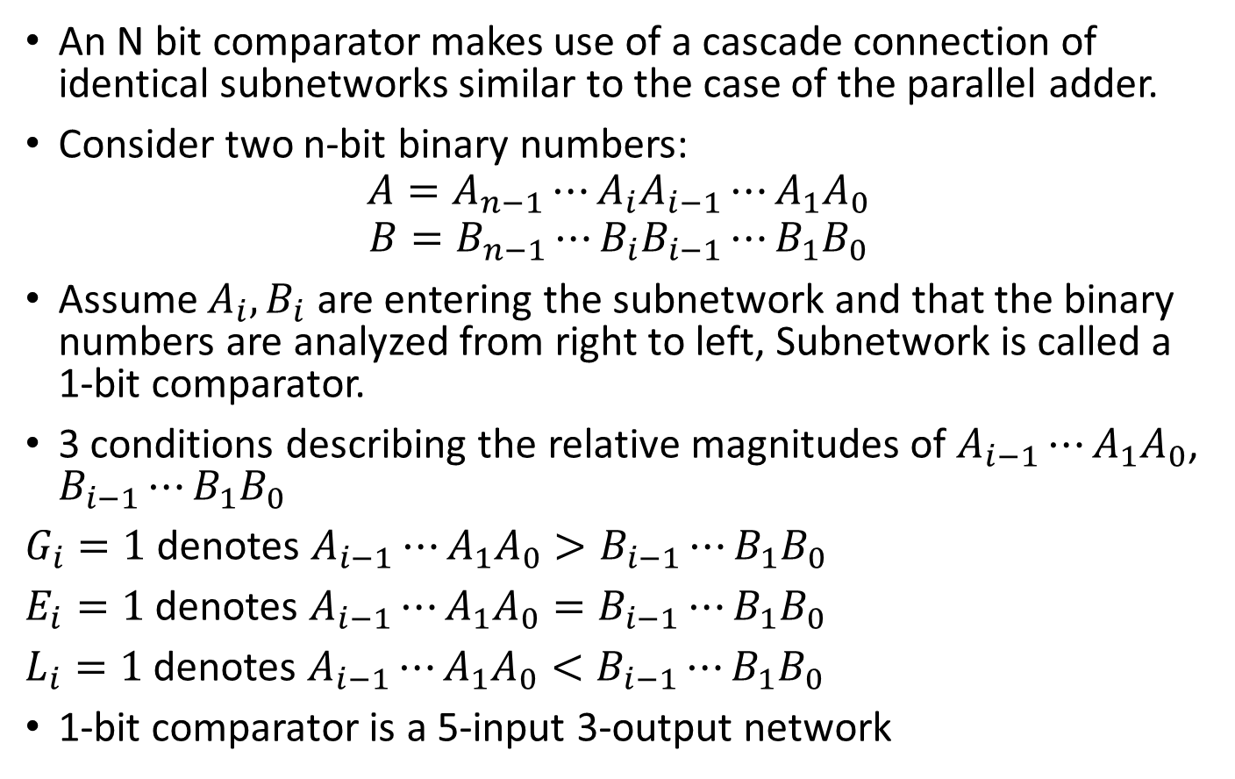
Designing of N bit Comparators
An N bit comparator makes use of a cascade connection of identical subnetworks similar to the case of the parallel adder.
Consider two n-bit binary numbers:
$$A=A_{n−1}⋯A_{i}A_{i−1}⋯A_{1}A_{0}$$
$$B=B_{n−1}⋯B_{i}B_{i−1}⋯B_{1}B_{0}$$
Assume $A_{i}, B_{i}$ are entering the subnetwork and that the binary numbers are analyzed from right to left, Subnetwork is called a 1-bit comparator.
3 conditions describing the relative magnitudes of $A_{i−1}⋯A_{1}A_{0}$, $B_{i−1}⋯B_{1}B_{0}$
$G_{i}=1$ denotes $A_{i−1}⋯A_{1}A_{0}>B_{i−1}⋯B_{1}B_{0}$
$E_{i}=1$ denotes $A_{i−1}⋯A_{1}A_{0}=B_{i−1}⋯B_{1}B_{0}$
$L_{i}=1$ denotes $A_{i−1}⋯A_{1}A_{0}<B_{i−1}⋯B_{1}B_{0}$
1-bit comparator is a 5-input 3-output network

Slide 25
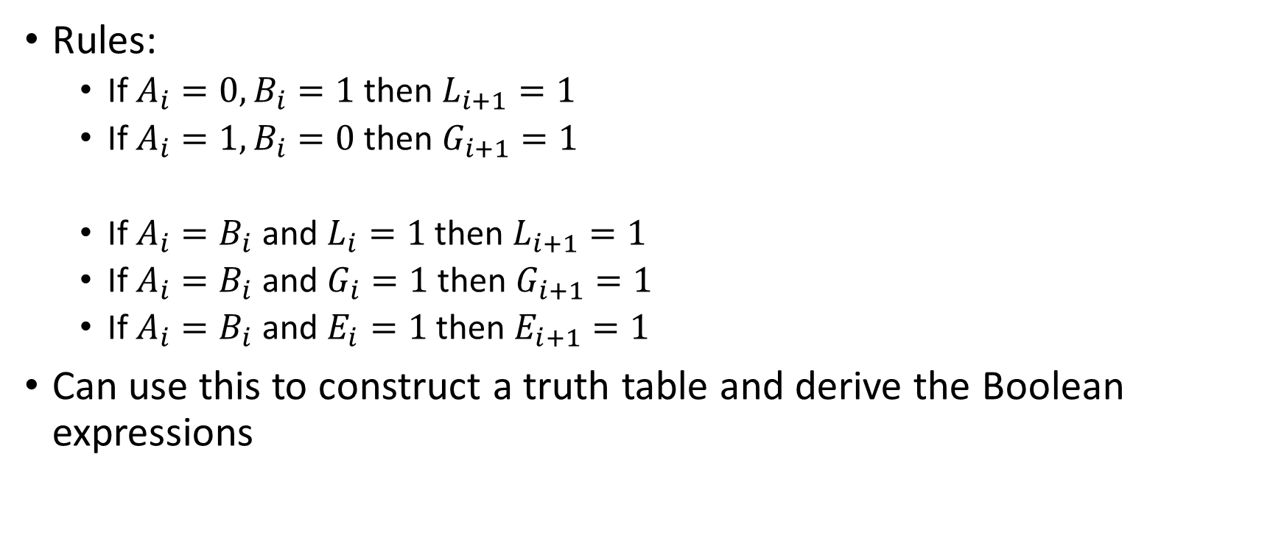
Rules:
If $A_{i}=0, B_{i}=1$ then $L_{i+1}=1$
If $A_{i}=1, B_{i}=0$ then $G_{i+1}=1$
If $A_{i}=B_{i}$ and $L_{i}=1$ then $L_{i+1}=1$
If $A_{i}=B_{i}$ and $G_{i}=1$ then $G_{i+1}=1$
If $A_{i}=B_{i}$ and $E_{i}=1$ then $E_{i+1}=1$
Can use this to construct a truth table and derive the Boolean expressions

Slide 26
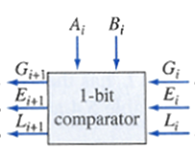
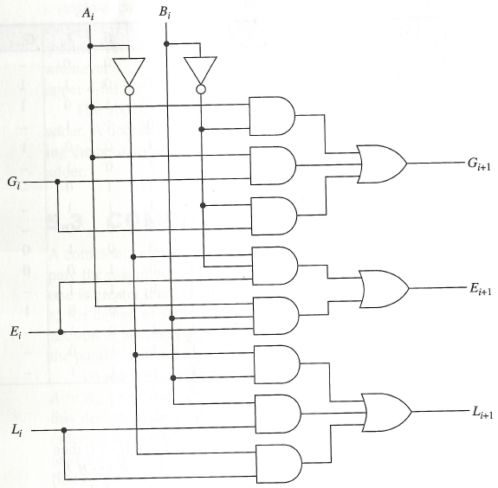
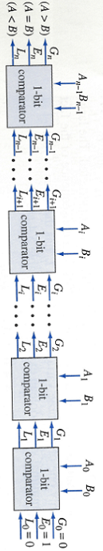

Minimal Sum Boolean Expressions:
$G_{i+1}=A_{i}{\overline{B}}_{i}+A_{i}G_{i}+{\overline{B}}_{i}G_{i}$
$$E_{i+1}={\overline{A}}_{i}{\overline{B}}_{i}E_{i}+A_{i}B_{i}E_{i}$$
$${ L}_{i+1}={\overline{A}}_{i}B_{i}+B_{i}L_{i}+{\overline{A}}_{i}L_{i}$$

